Slide 1
ADF Pipeline (Orchestrate)
On Prem MySQL → ADF → Azure SQL Database

Slide 2
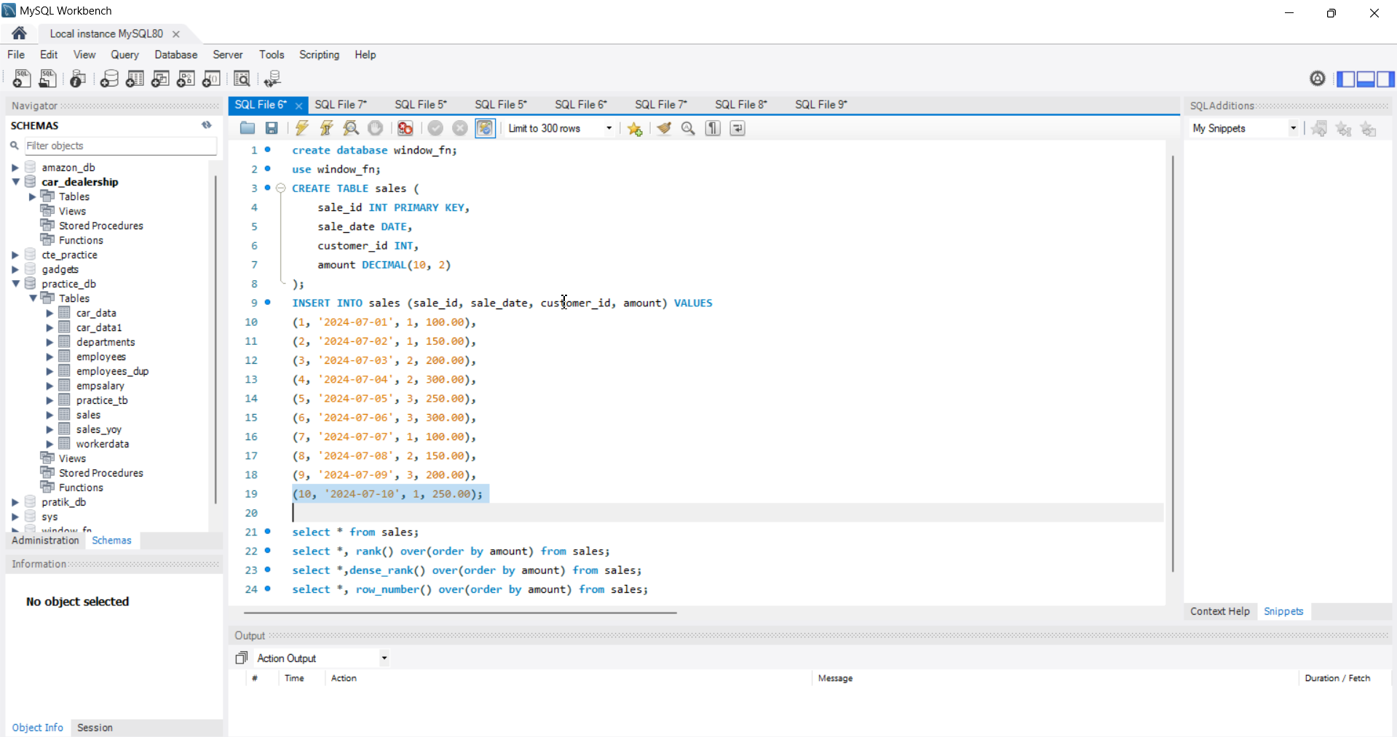
Create ADF, Azure SQL database and MySQL database OnPrem

Slide 3
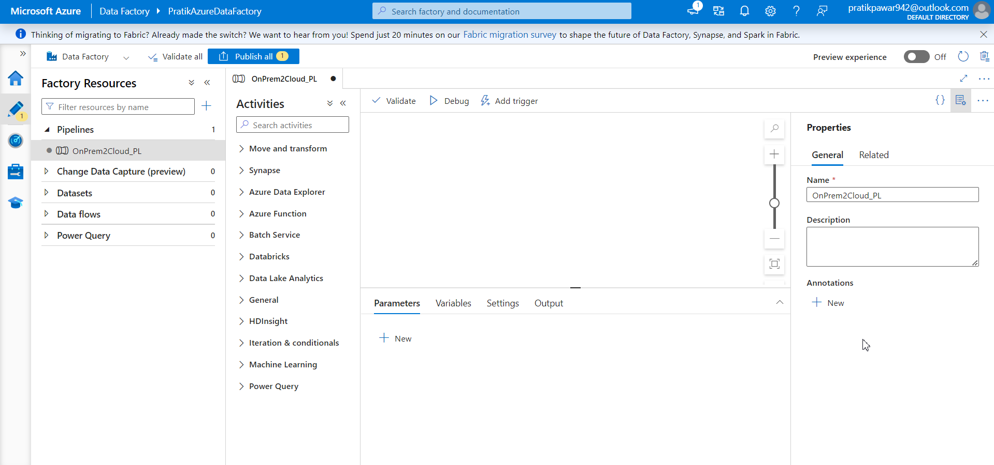
Create Pipeline and name as OnPrem2Cloud_PL

Slide 4
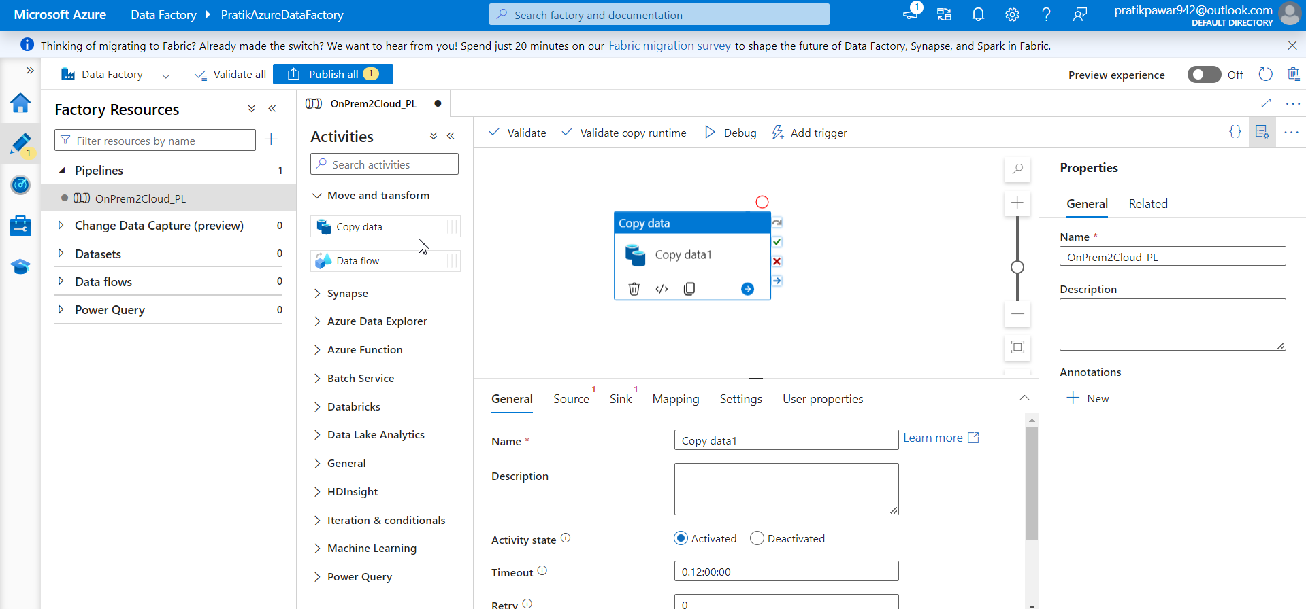
Use Copy Data

Slide 5
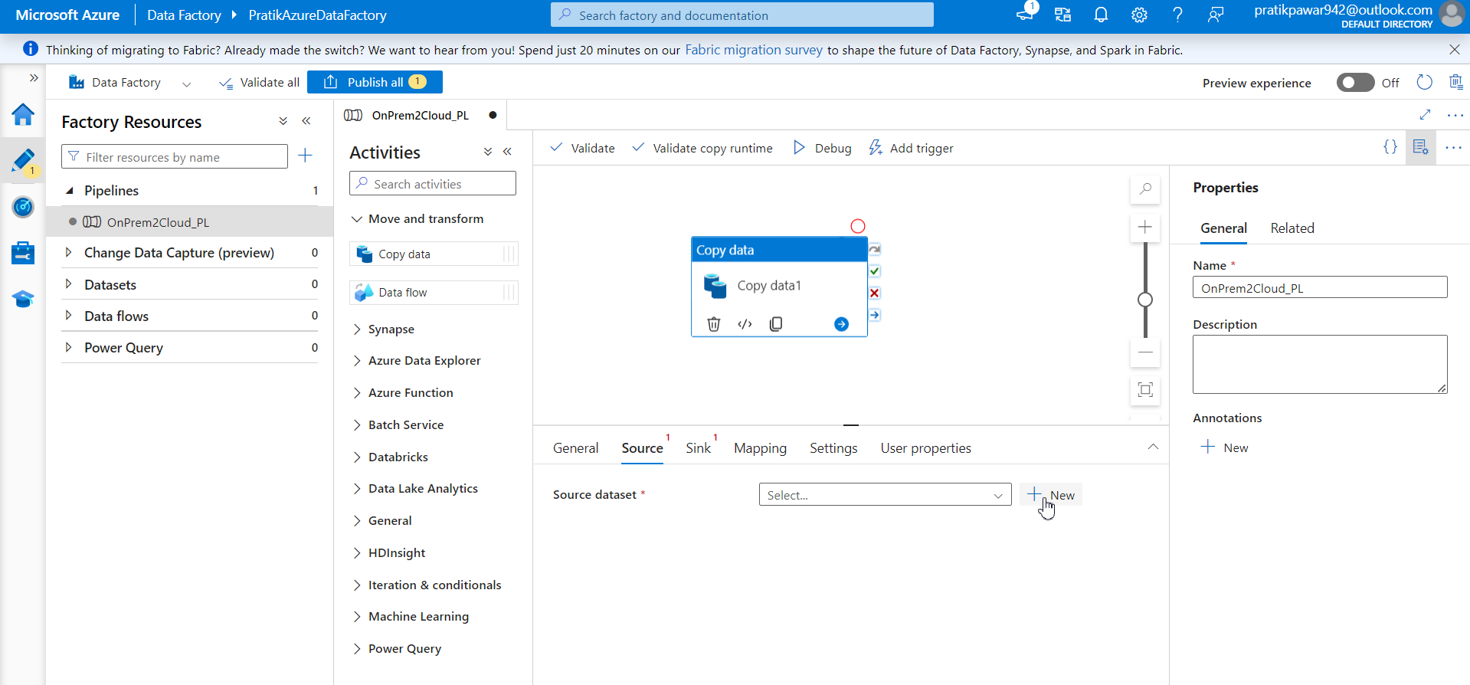
Go to source and create new dataset

Slide 6
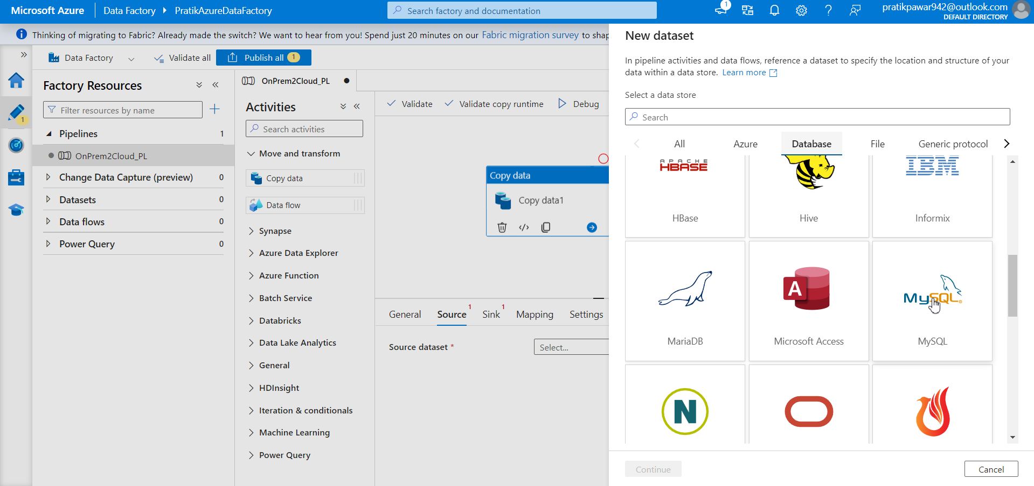
Go to database → MySQL

Slide 7
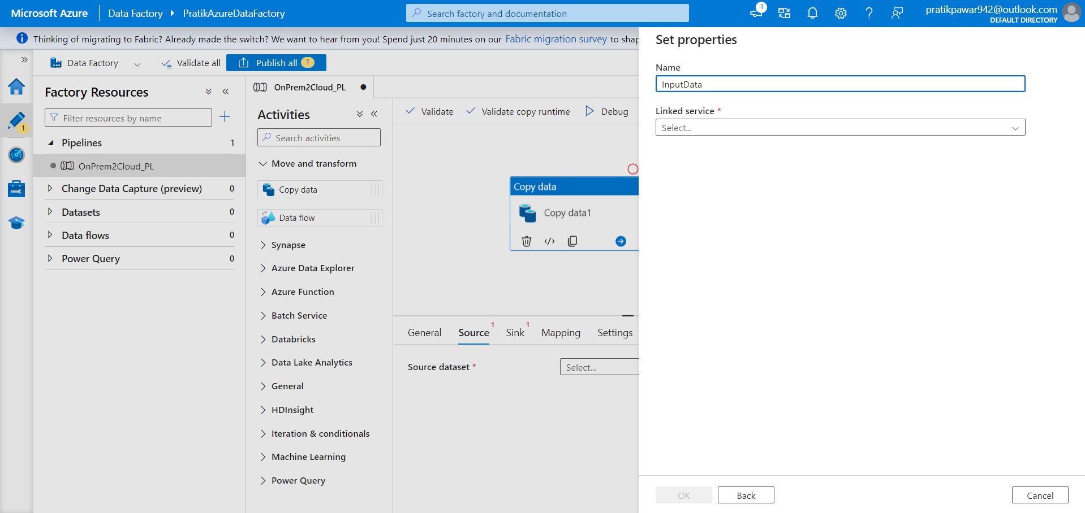
Give name input data

Slide 8
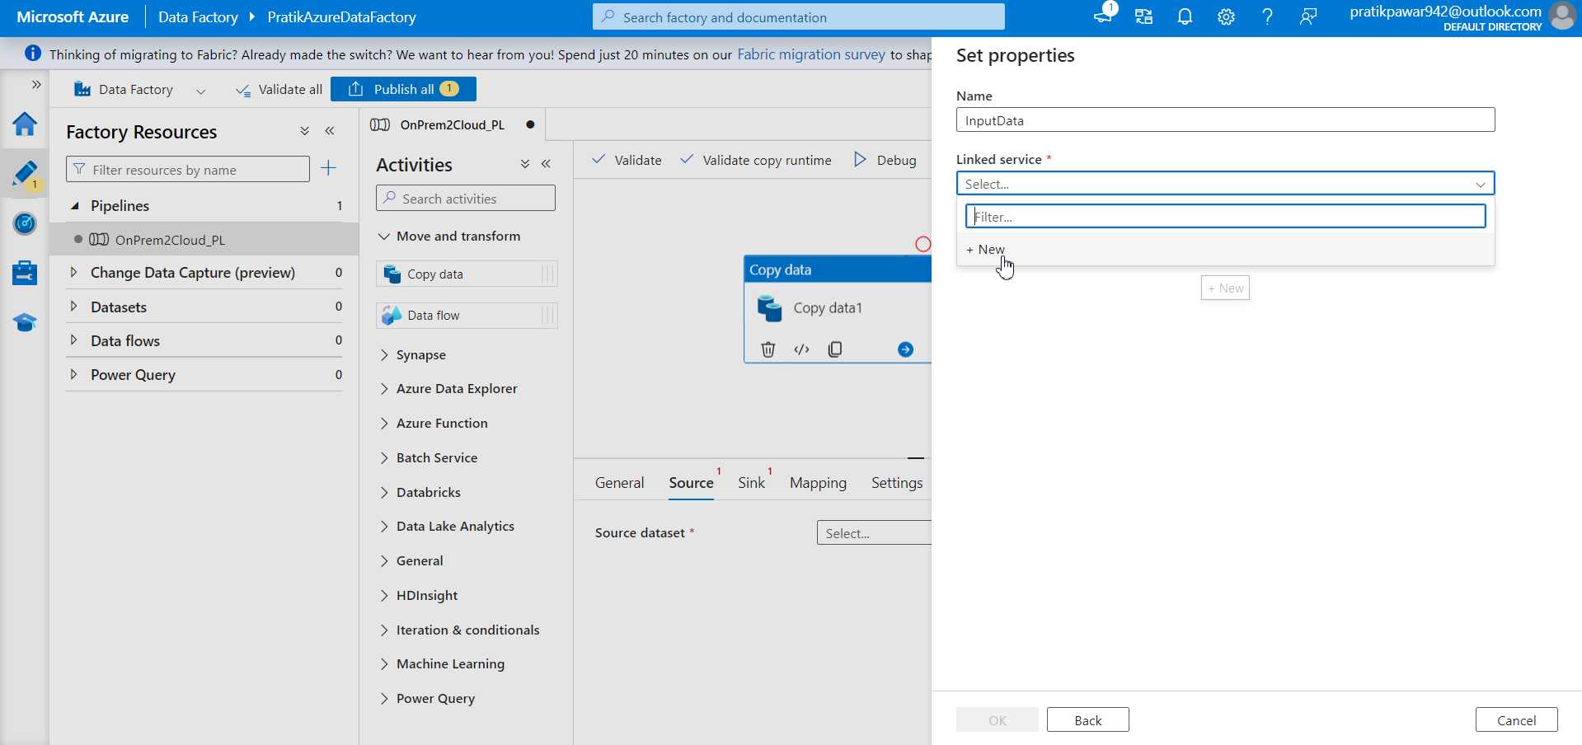
Create New linked service

Slide 9
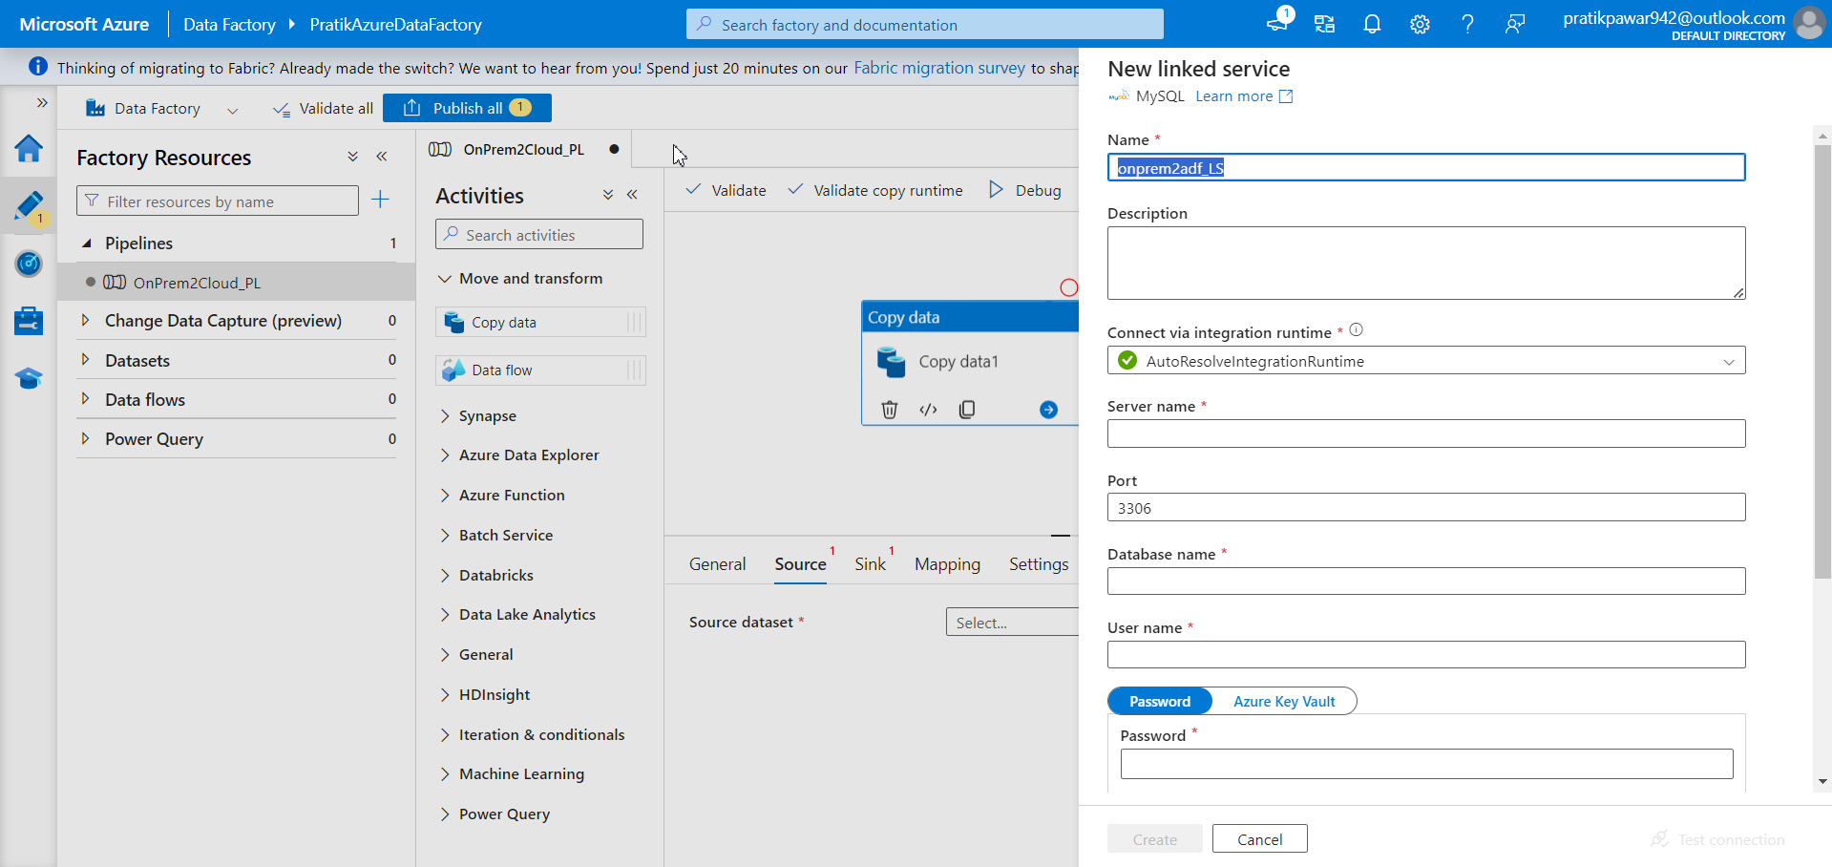
Give name onprem2adf_LS

Slide 10
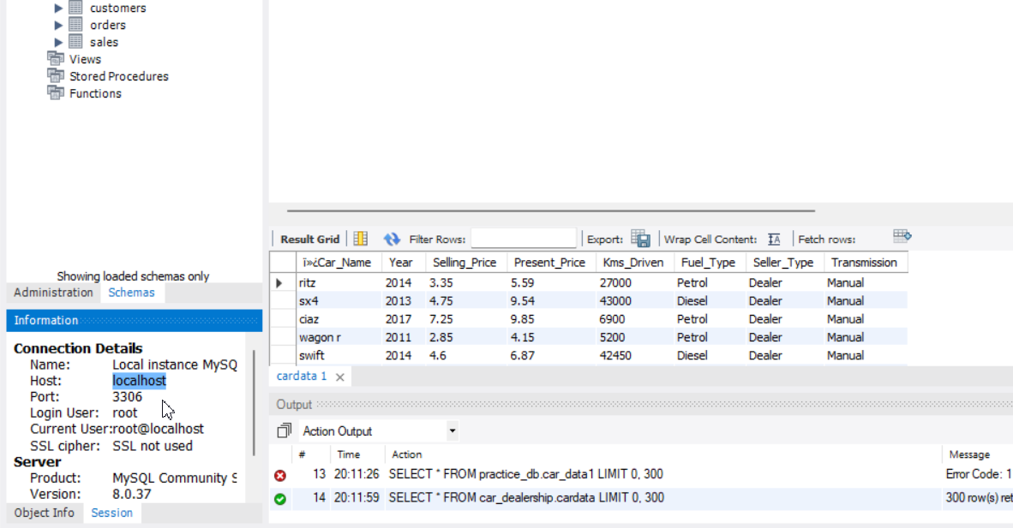
Give server name and local host from here to adf ( server name = host)

Slide 11
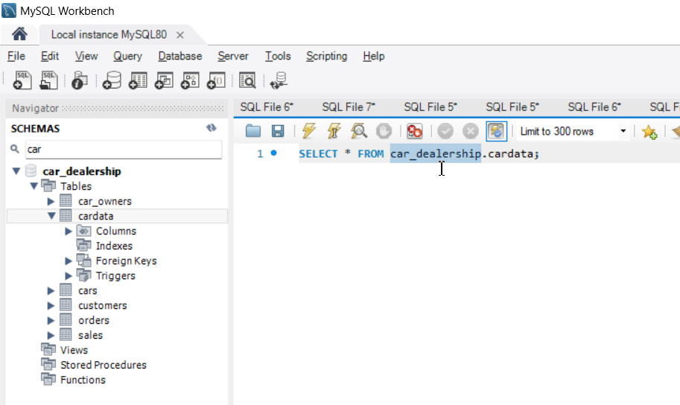
Give database name = car_dealership

Slide 12
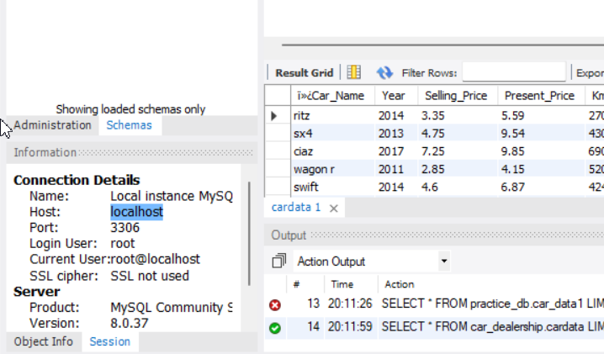
Username is Root

Slide 13
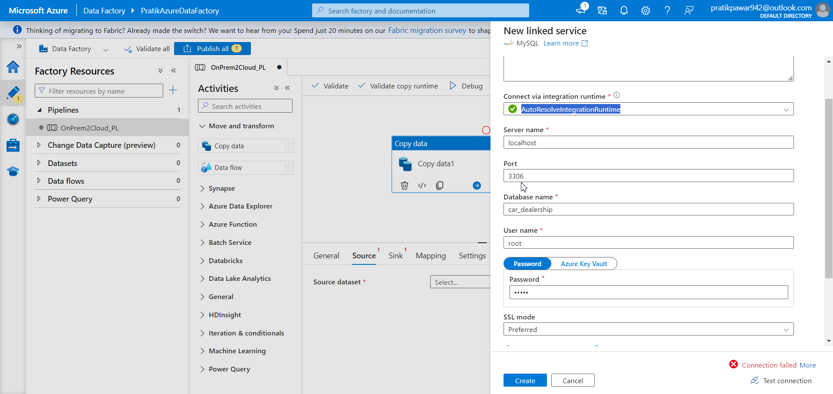
Fill all the required details from MySQL to ADF

Slide 14
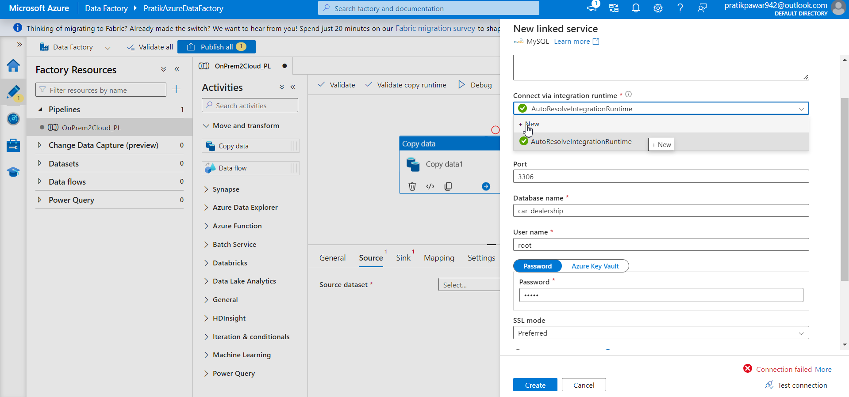
Go to integration runtime to create self hosted integration runtime

Slide 15
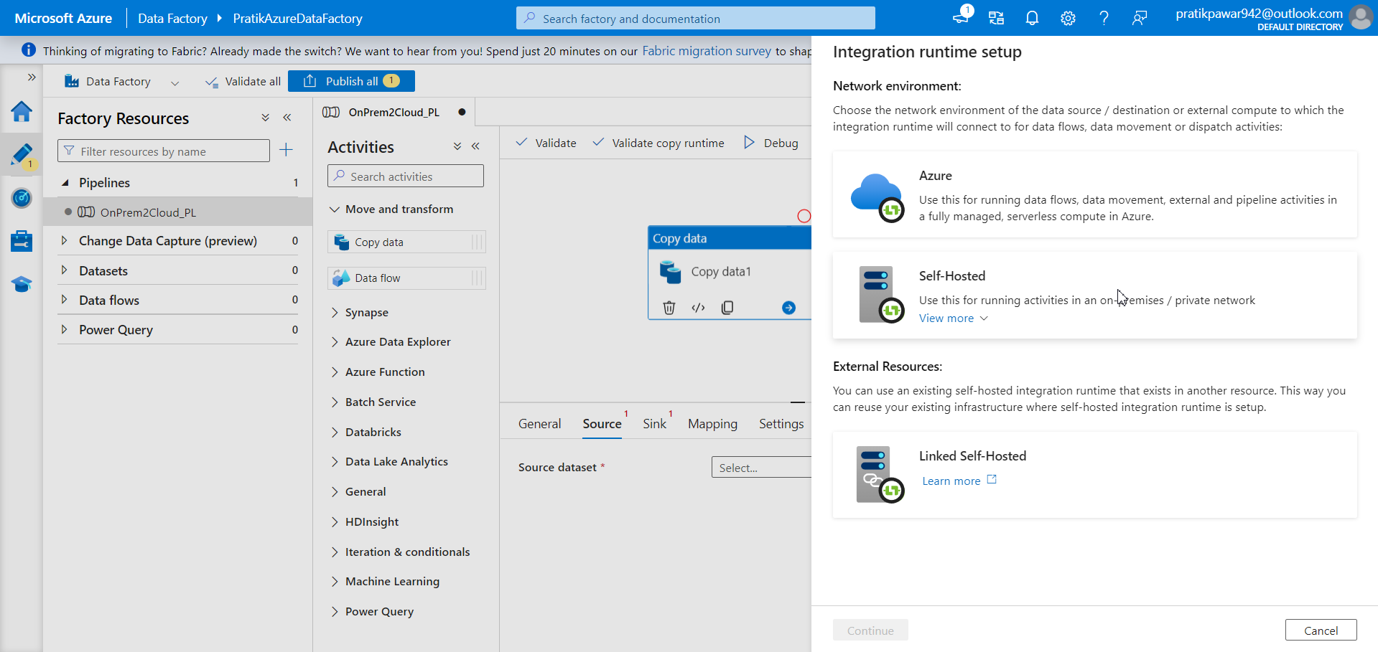
Self Hosted to move data from onpremesis to cloud

Slide 16
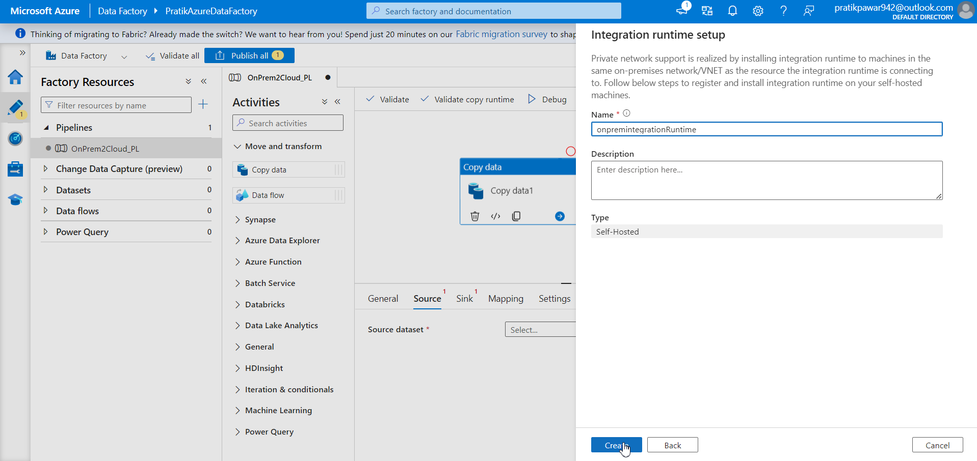
Give name and click create

Slide 17
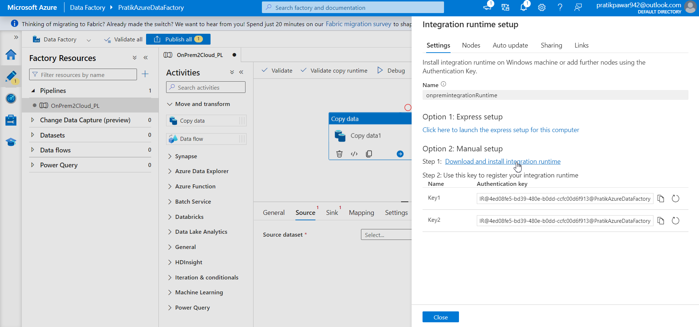
Download integration runtime software to move data from onprem to cloud

Slide 18
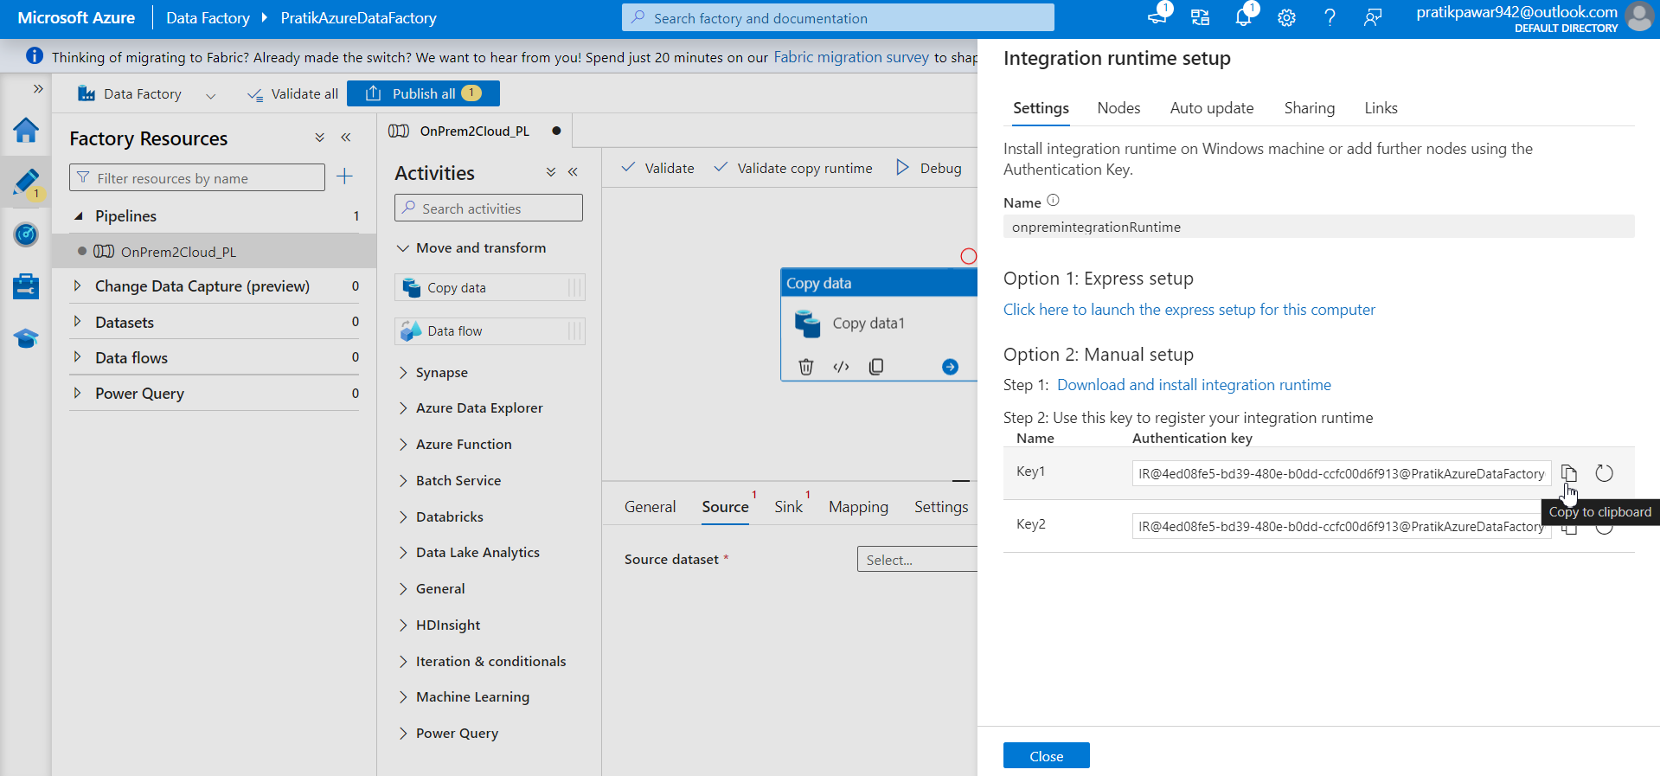
After installation of software copy this and paste in it

Slide 19
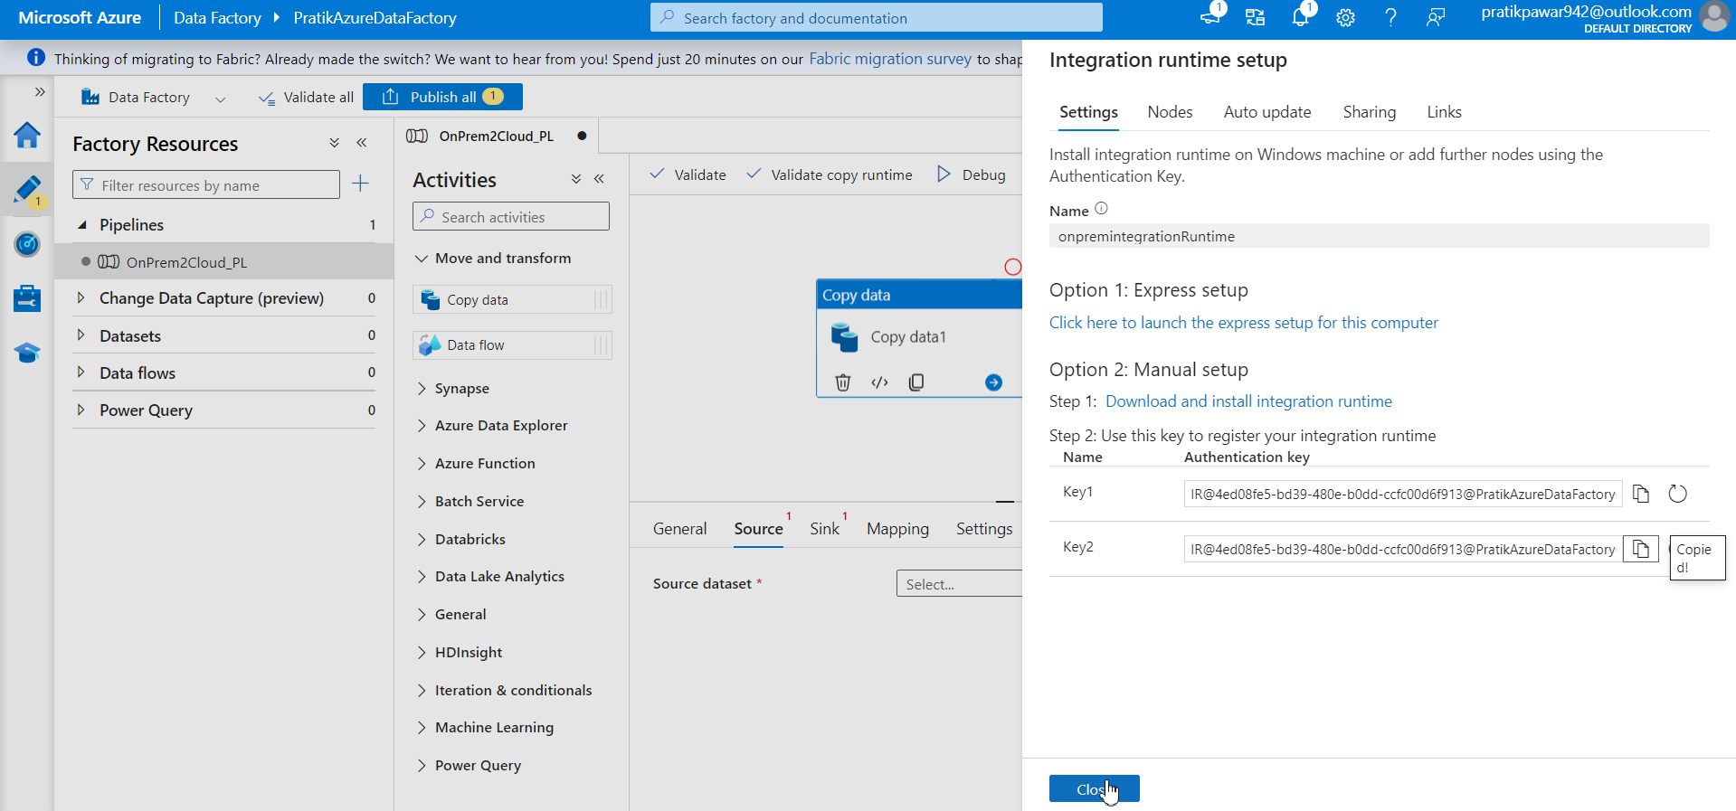
Close

Slide 20
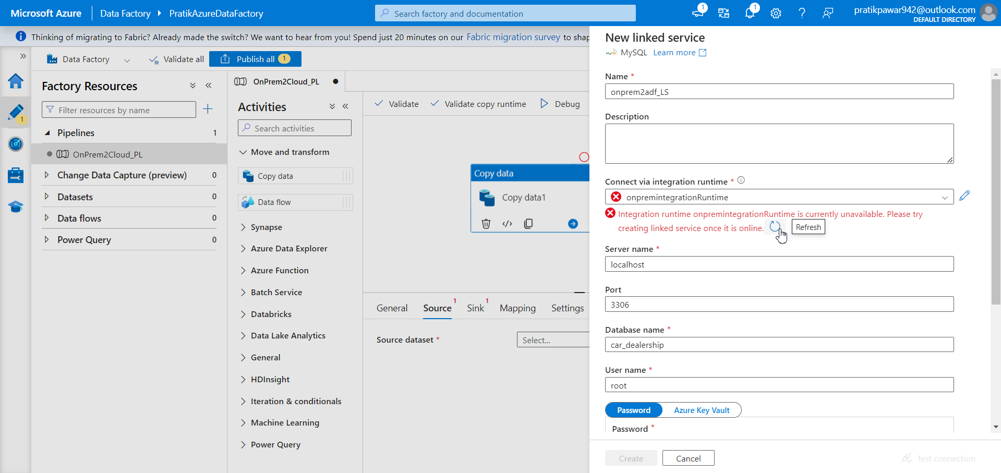
Refresh it

Slide 21
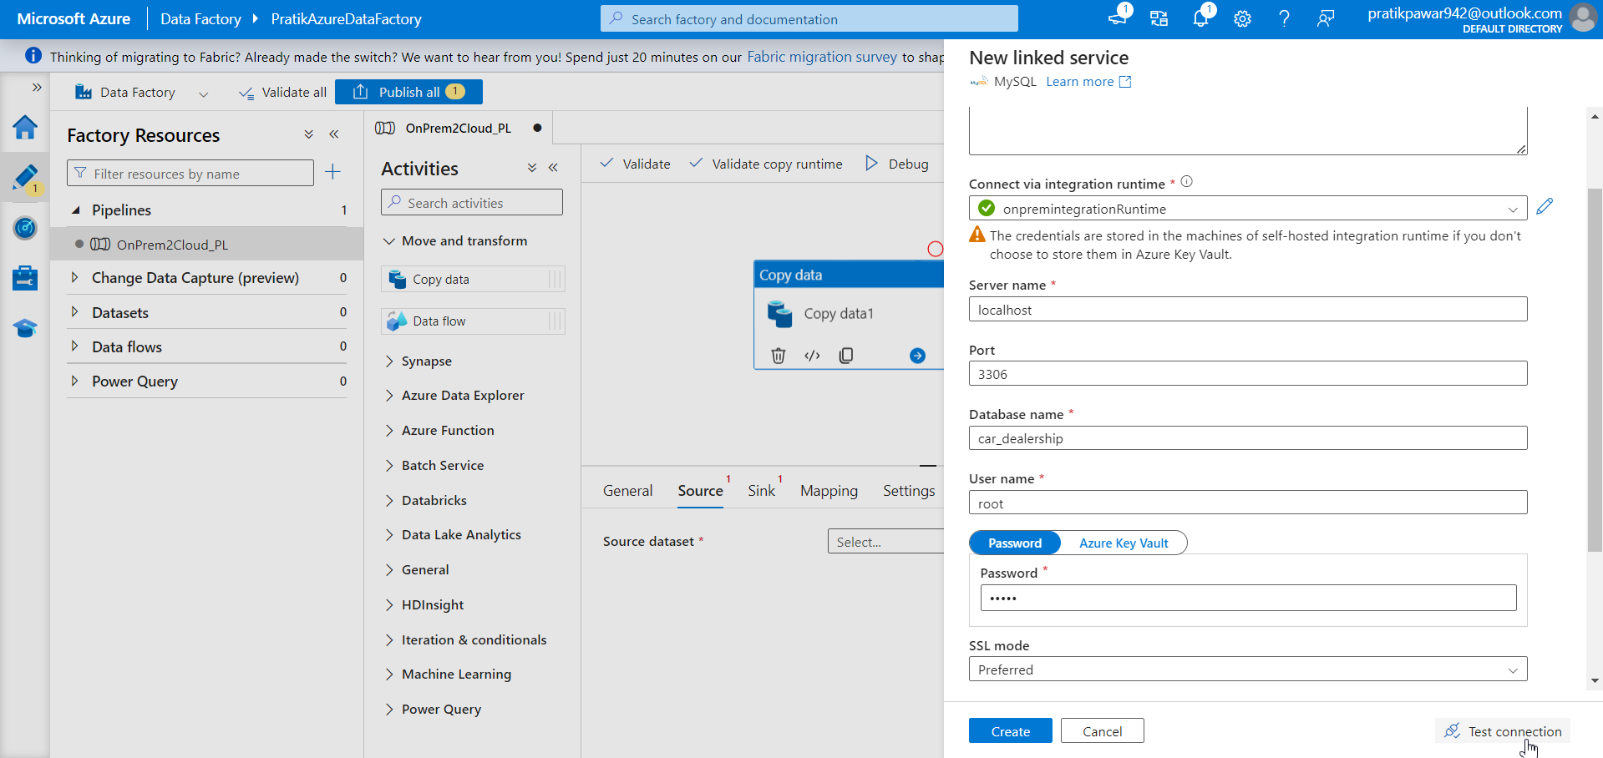
Test connectiom

Slide 22

Create

Slide 23
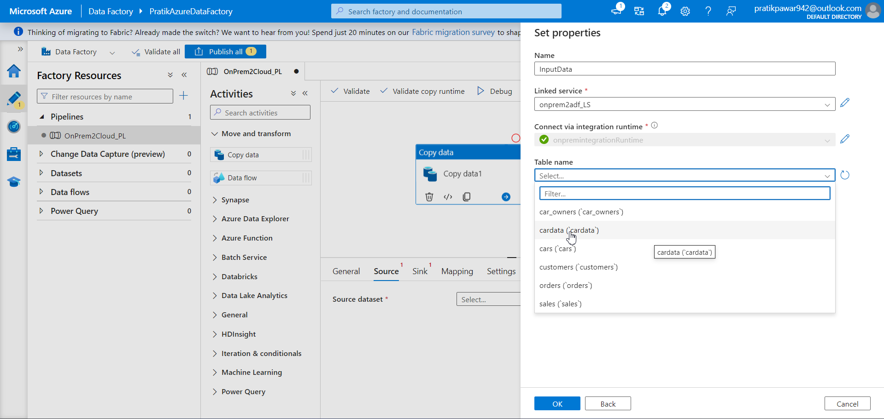
Select cardata

Slide 24
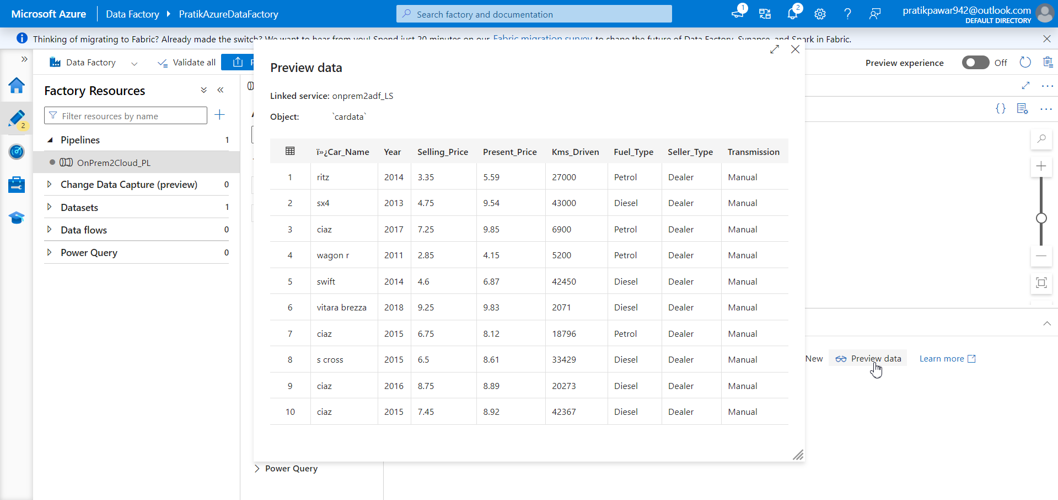
Go to preview data to see data

Slide 25
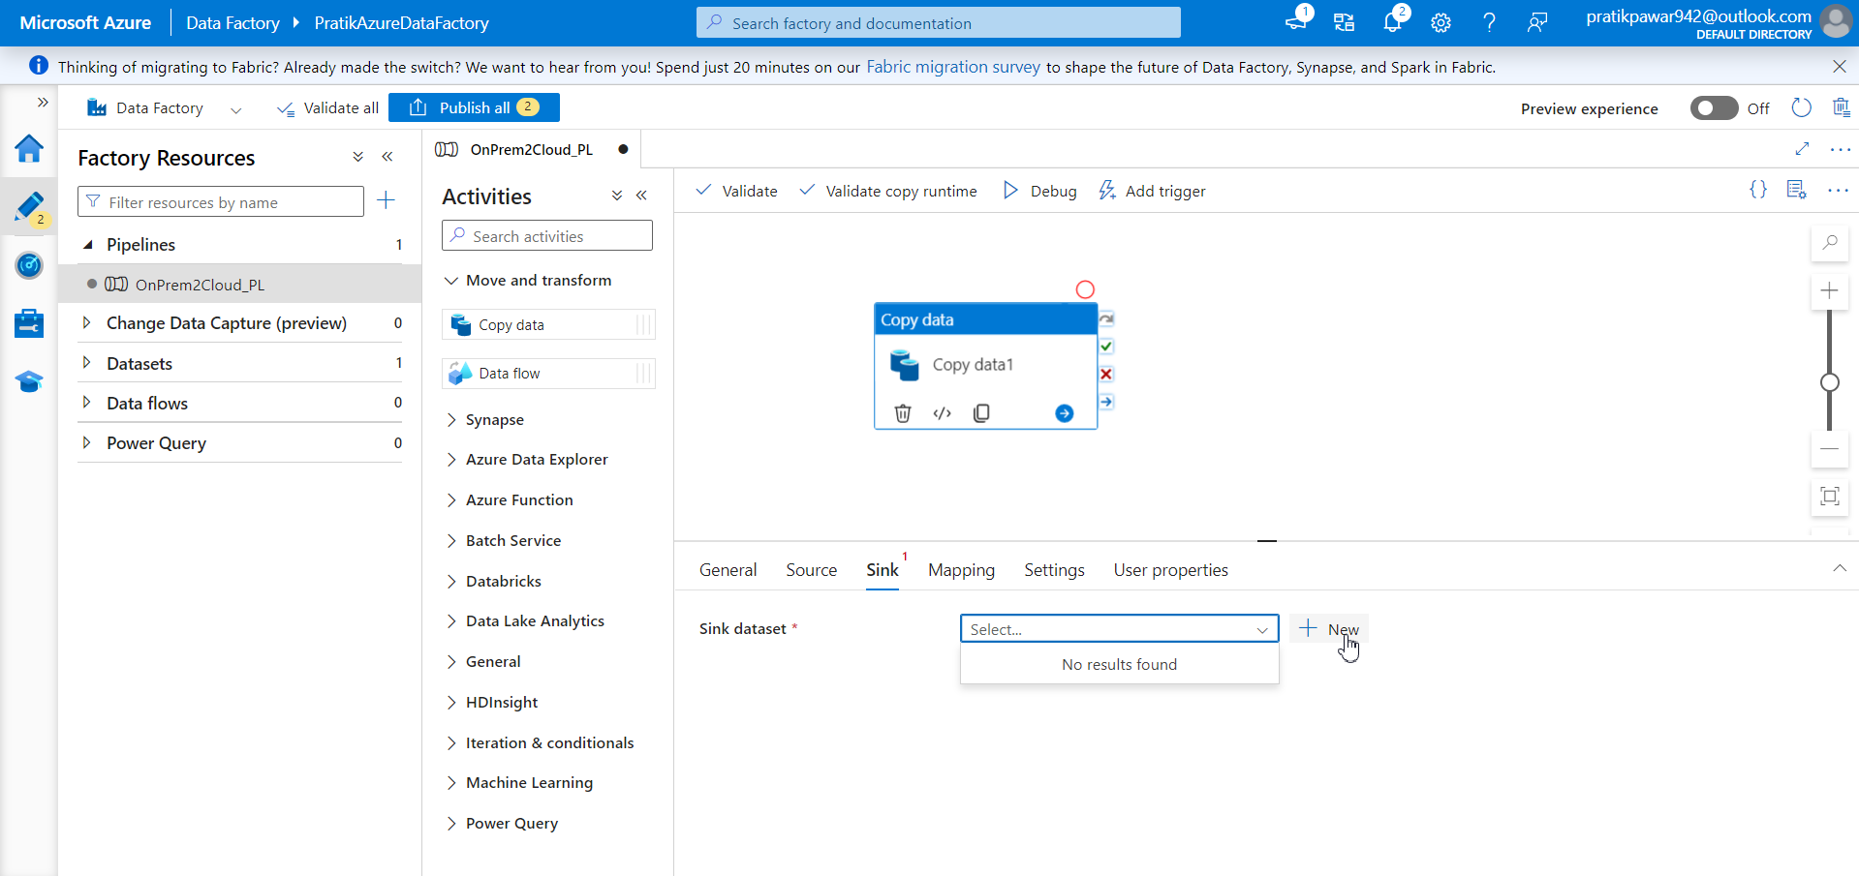
Sink → new

Slide 26
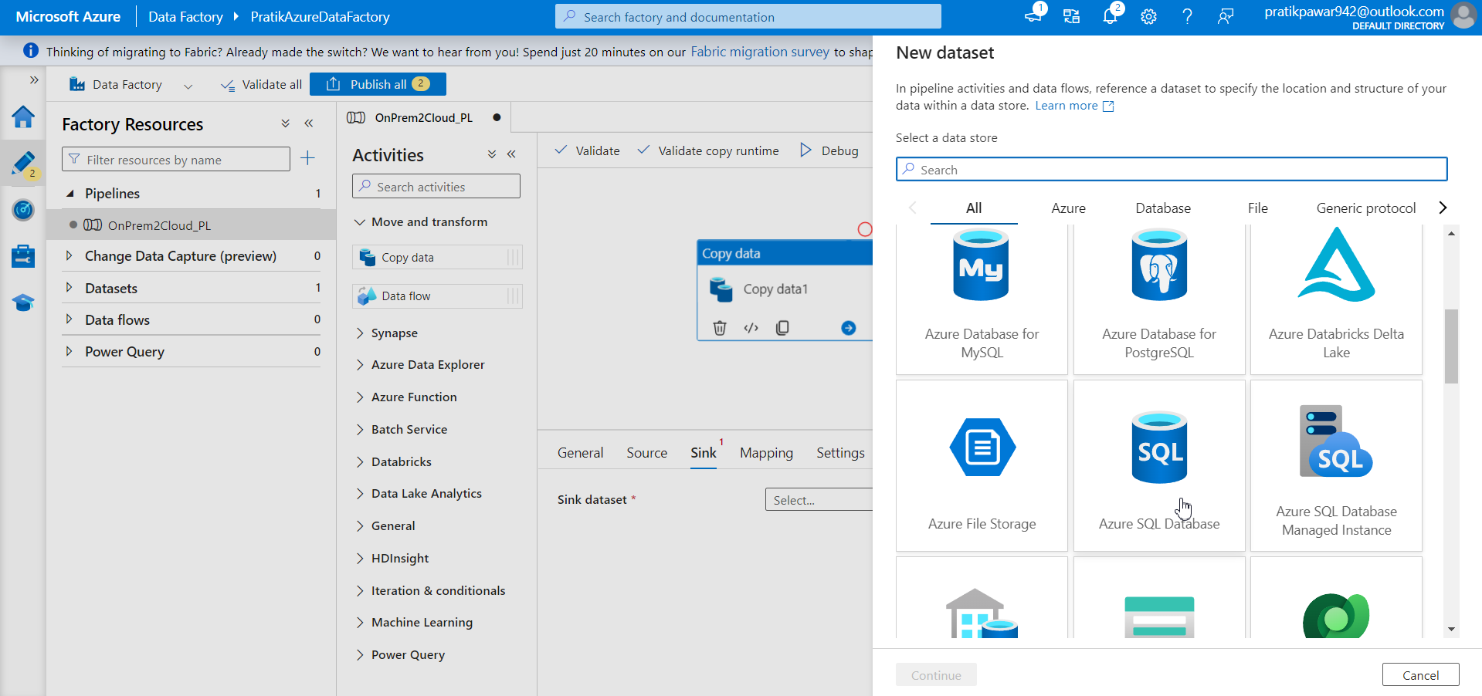
Azure SQL database

Slide 27

Give name outputdata and create new linked service

Slide 28
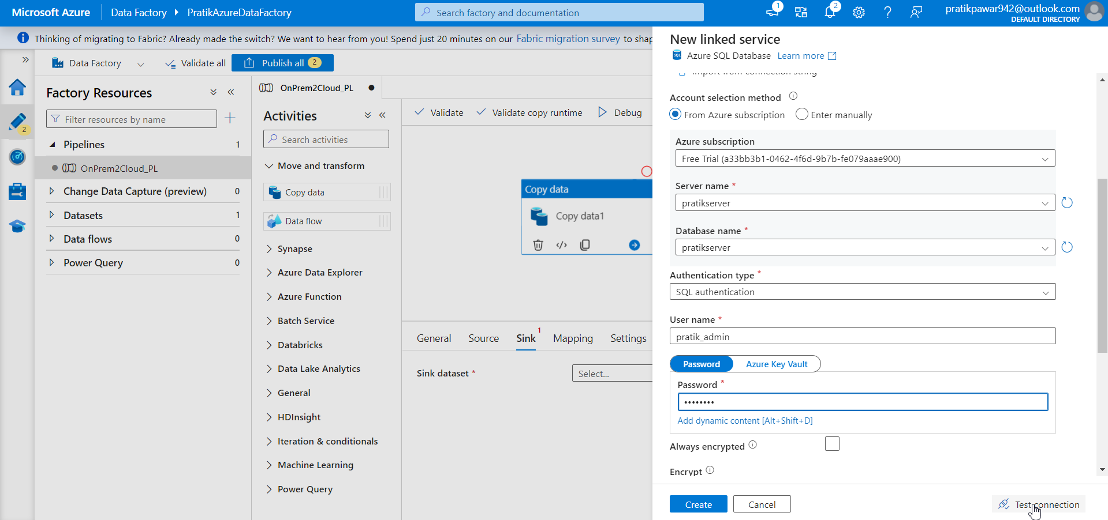
Fill all details and test connection

Slide 29
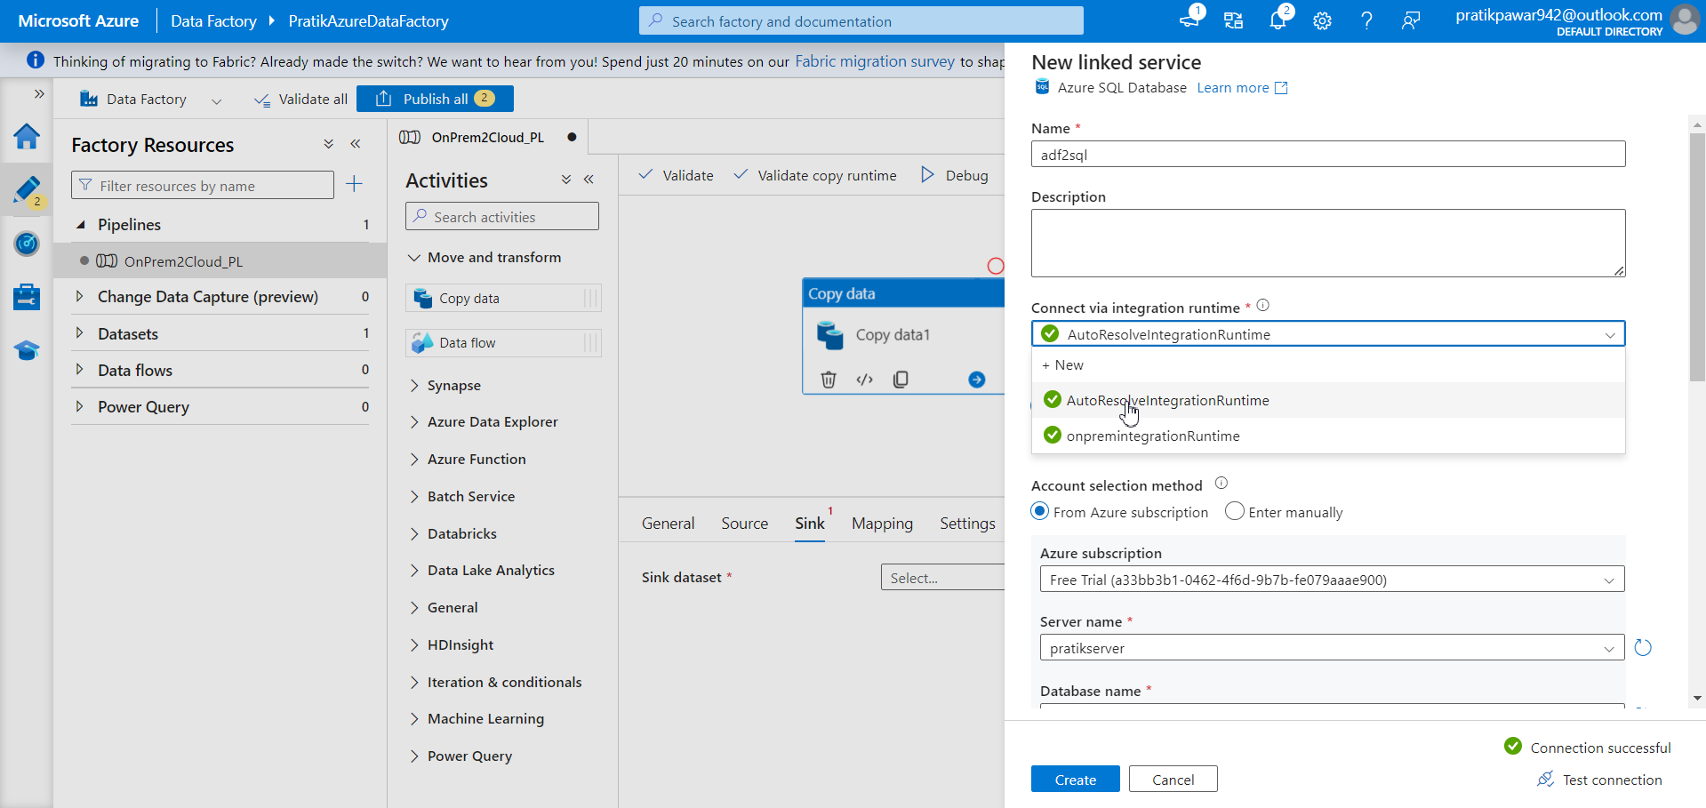
This time we are moving data from adf to azure sql database (cloud to cloud) so autoresolveintegrationruntime

Slide 30
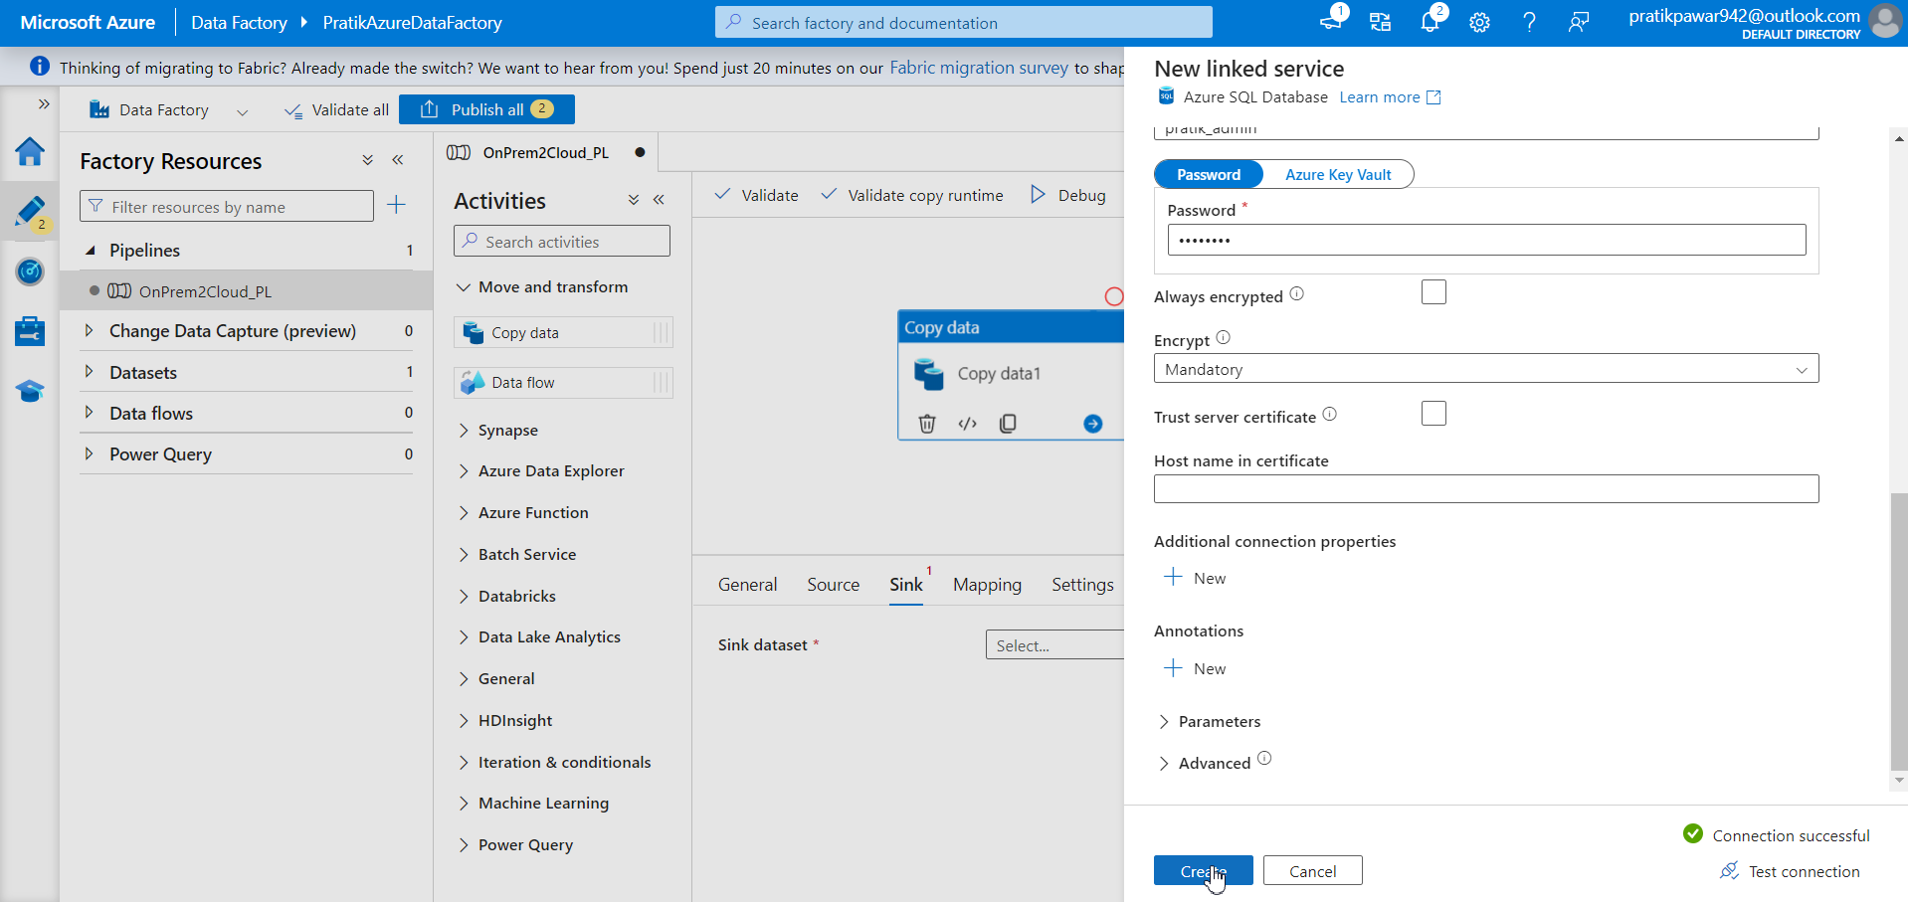
create

Slide 31
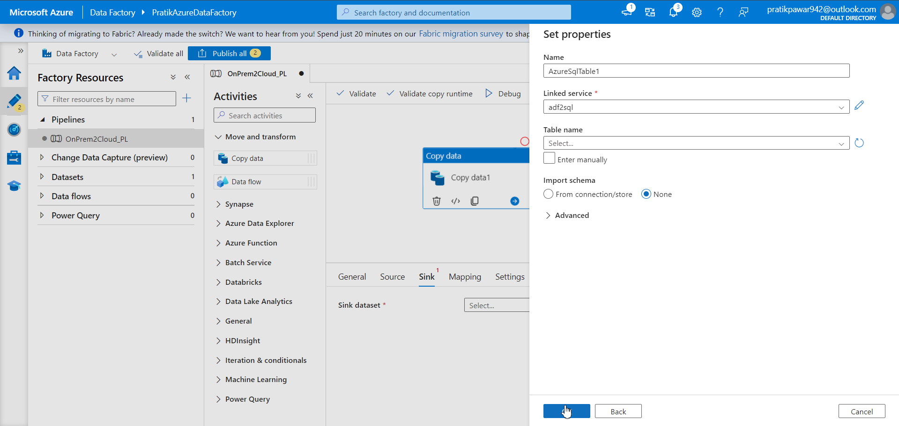
Click ok

Slide 32
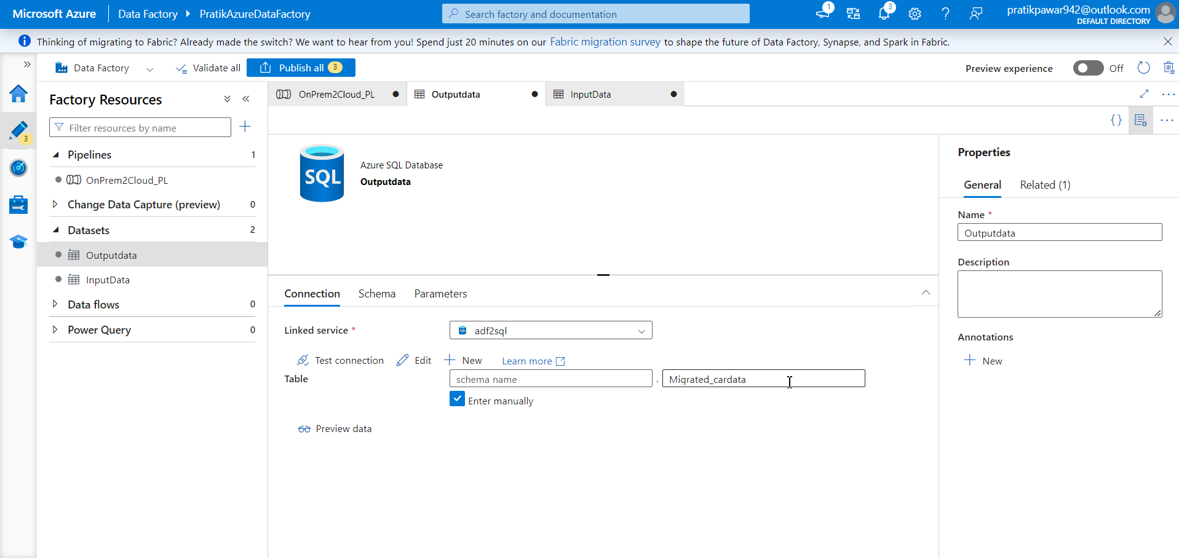
Go to datasets > outputdata > enter manually > rename the name of data which we are going to migrate

Slide 33
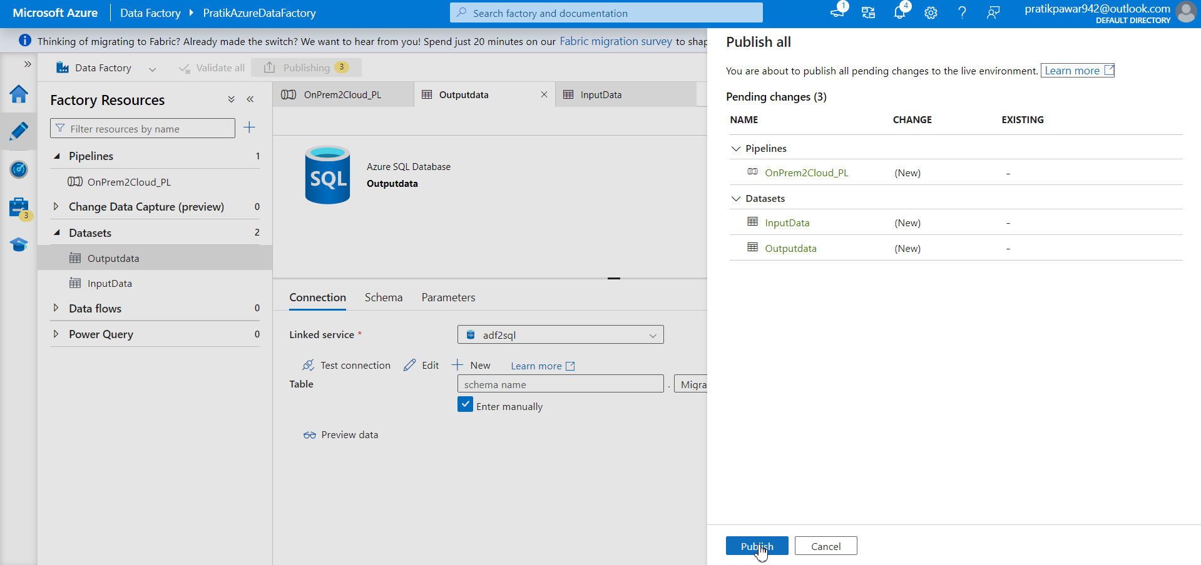
Publish

Slide 34
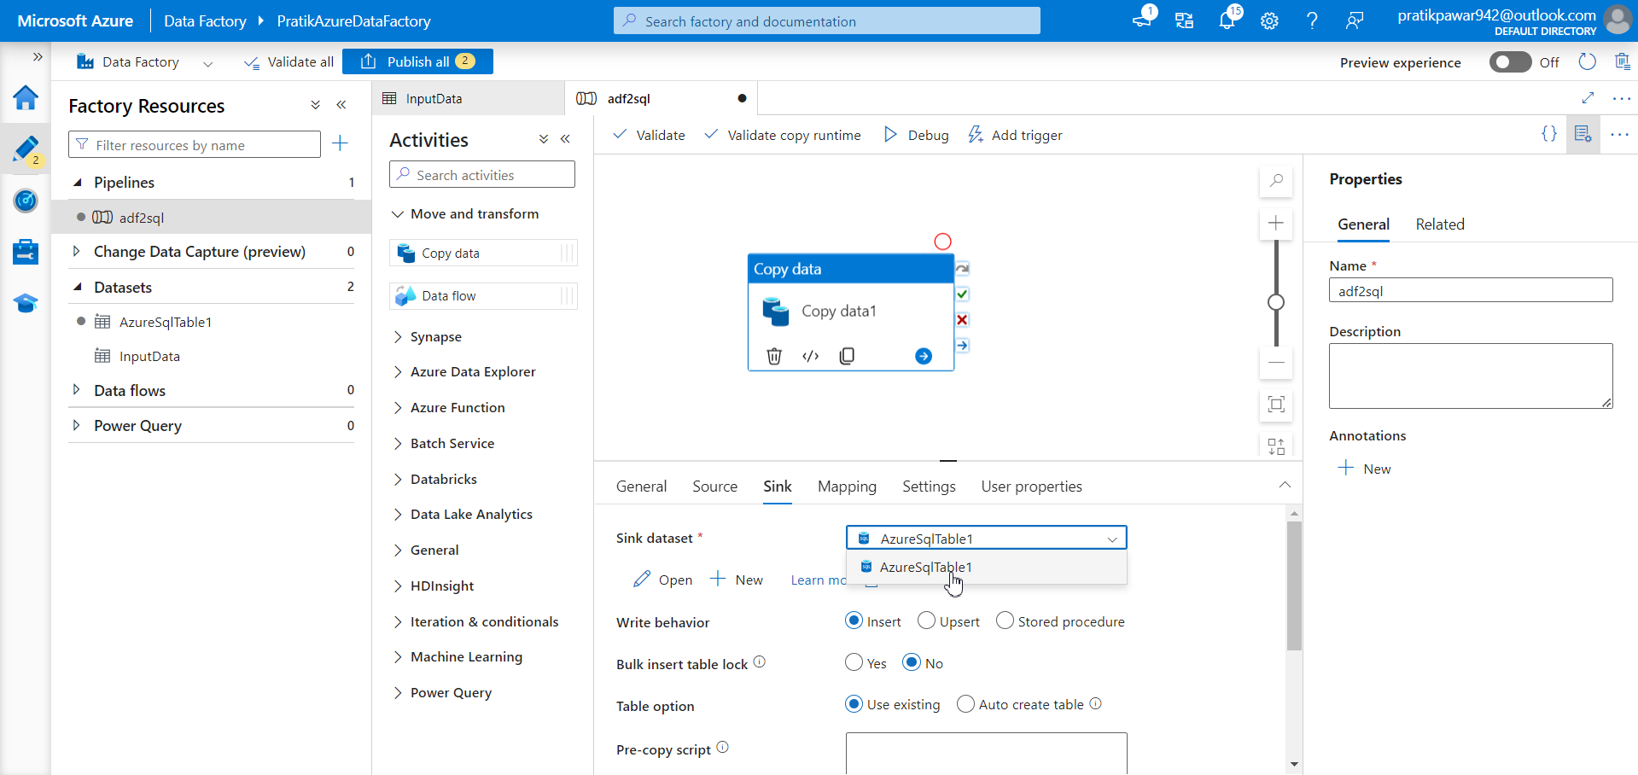
Go to sink > Azuresqltable1

Slide 35
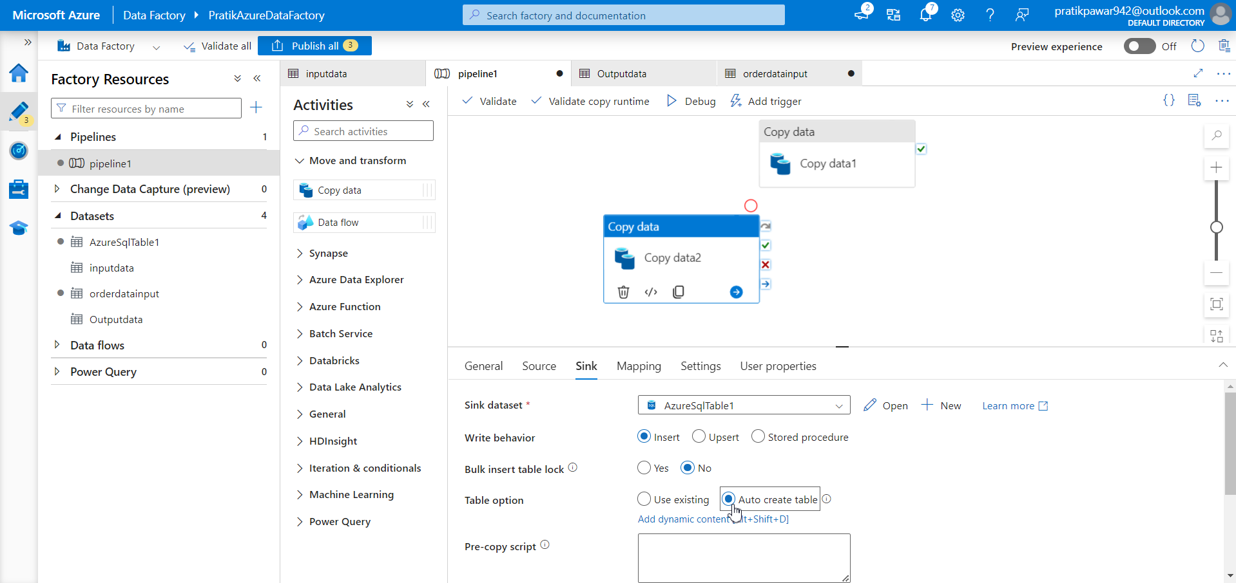
Warning : always use set SQL_SAFE_UPDATES = 0 in Mysql and use table option as auto create table or else pipeline will fail

Slide 36
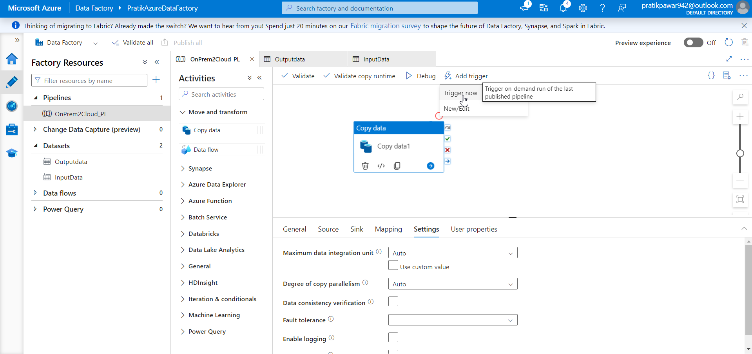
GO to add trigger > trigger now

